Slide 1
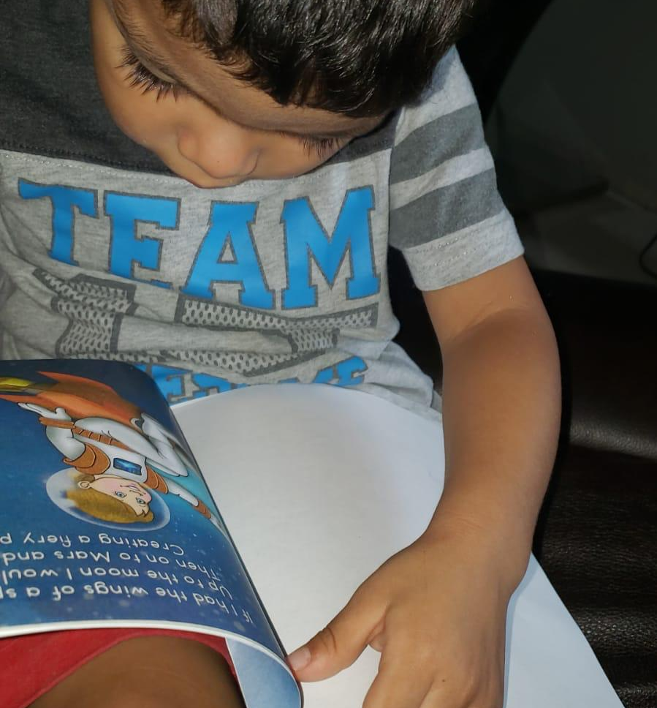
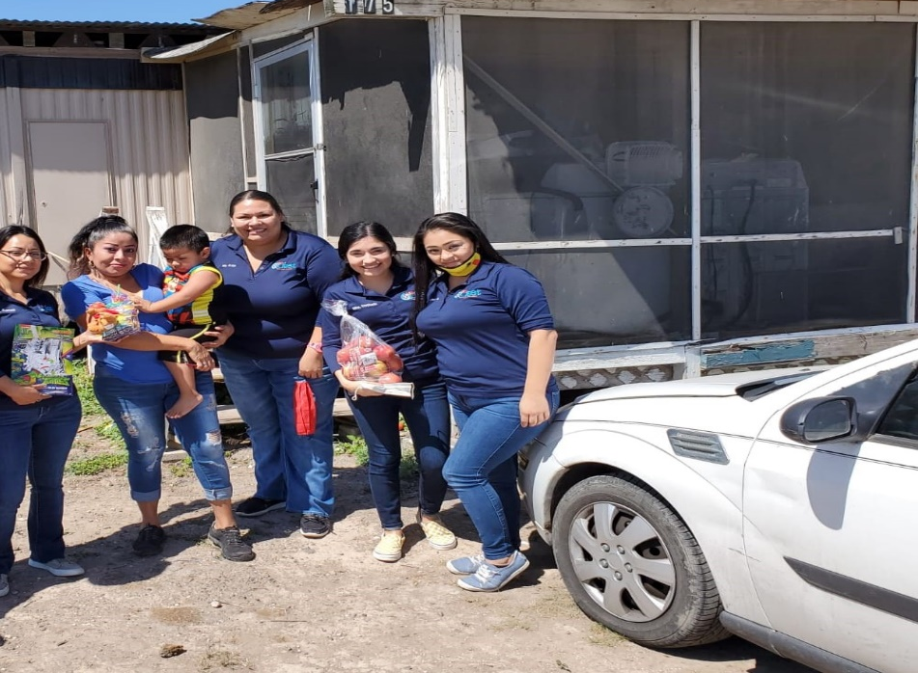
UTRGV Partnership Sites
Reopening of Centers During
Covid-19

Slide 2
Learning Objectives
Review the CDC & State guidelines regarding the COVID-19 Virus
Review new procedures due to the COVID-19
Practice effective decision-making skills using CDC & State Guidelines

Slide 3
Know about COVID-19
Coronavirus (COVID-19) is an illness caused
by a virus that can spread from person
to person.
• The virus that causes COVID-19 is a new
coronavirus that has spread throughout
the world.
• COVID-19 symptoms can range from mild
(or no symptoms) to severe illness.

Slide 4
Know how COVID-19 is spread
You can become infected by coming into
close contact (about 6 feet or two
arm lengths) with a person who has
COVID-19. COVID-19 is primarily spread
from person to person.
You can become infected from respiratory
droplets when an infected person coughs,
sneezes, or talks.

Slide 5
Know how COVID-19 is spread
You may also be able to get it by touching a
surface or object that has the virus on it, and
then by touching your mouth, nose, or eyes.

Slide 6

Protect yourself and others from COVID-19
There is currently no vaccine to protect against COVID-19. The best way to protect yourself is to avoid being exposed to the virus that causes COVID-19.
Stay home as much as possible and avoid close contact with others.

Slide 7
Protect yourself and others from COVID-19
Wear a cloth face covering that covers your nose and mouth in public settings.
Clean and disinfect frequently touched surfaces.
Wash your hands often with soap and water for at least 20 seconds, or use an alcohol-based hand sanitizer that contains at least 60% alcohol.

Slide 8
Practice social distancing
Buy groceries and medicine, go to the doctor, and complete banking activities online when possible.
• If you must go in person, stay at least 6 feet away from others and disinfect items you
must touch.
• Get deliveries and takeout, and limit in-person contact as much as possible.

Slide 9
Prevent the spread of COVID-19 if you are sick
Stay home if you are sick, except to get medical care.
• Avoid public transportation, ride-sharing, or taxis.
• Separate yourself from other people and pets in your home.

Slide 10
Prevent the spread of COVID-19 if you are sick
• There is no specific treatment for COVID-19, but you can seek medical care to help relieve
your symptoms.
• If you need medical attention, call ahead.

Slide 11
Know your risk for severe illness
• Everyone is at risk of getting COVID-19.
• Older adults and people of any age who have serious underlying medical conditions may be at higher risk for more severe illness.

Slide 12
Federal and state health protocols for serving children in child care:
Implement Social Distancing Strategies
If possible, childcare classes should include the same group each day, and the same childcare providers should remain with the same group each day.
Limit the mixing of children, such as staggering playground times and keeping groups separate for special activities such as art, music, and exercising.

Slide 13
Implement Social Distancing Strategies
If possible, at nap time, ensure that children’s naptime mats (or cribs) are spaced out as much as possible, ideally 6 feet apart.
Consider placing children head to toe in order to further reduce the potential for viral spread.

Slide 14
Implement Social Distancing Strategies
Consider staggering arrival and drop off times and/or have childcare providers come outside the facility to pick up the children as they arrive.
Your plan for curb side drop off and pick up should limit direct contact between parents and staff members and adhere to social distancing recommendations.

Slide 15
Implement Social Distancing Strategies
Cancel or postpone special events such as festivals, holiday events, and special performances.

Slide 16
Intensify Clean and Sanitize
High touch surfaces made of plastic or metal, such as grab bars and railings should be cleaned routinely.
Toys that children have placed in their mouths or that are otherwise contaminated by body secretions or excretions should be set aside until they are cleaned by hand by a person wearing gloves.

Slide 17
Intensify Clean and Sanitize
Machine washable cloth toys should be used by one individual at a time or should not be used at all. These toys should be laundered before being used by another child.
Do not share toys with other groups of infants or toddlers, unless they are washed and sanitized before being moved from one group to the other.

Slide 18
Intensify Clean and Sanitize
Set aside toys that need to be cleaned. Place in a dish pan with soapy water or put in a separate container marked for “soiled toys
Use bedding (sheets, pillows, blankets, sleeping bags) that can be washed. Keep each child’s bedding separate, and consider storing in individually labeled bins, cubbies, or bags.

Slide 19
Intensify Clean and Sanitize
Cots and mats should be labeled for each child. Bedding that touches a child’s skin should be cleaned weekly or before use by another child.
When diapering a child, wash your hands and wash the child’s hands before you begin, and wear gloves.
Follow safe diaper changing procedures. Procedures should be posted in all diaper changing areas.

Slide 20
Intensify Clean and Sanitize
After diapering, wash your hands (even if you were wearing gloves) and disinfect the diapering area
High touch surfaces include: Tables, doorknobs, light switches, countertops, handles, desks, phones, keyboards, toilets, faucets, sinks, etc.

Slide 21
Intensify Clean and Sanitize
Cleaning and disinfecting your building or facility if someone is sick; Close off areas used by the person who is sick.
Open outside doors and windows to increase air circulation in the area.
Wait 24 hours before you clean or disinfect. If 24 hours is not feasible, wait as long as possible.
Outdoor areas, like playgrounds in schools and parks generally require normal routine cleaning, but do not require disinfection.
Do not spray disinfectant on outdoor playgrounds- it is not an efficient use of supplies and is not proven to reduce risk of COVID-19 to the public.

Slide 22
Food preparation and meal service
An operation should not serve family style meals. Each child should be provided individual meals and snacks.
Meals should be served in the classroom and teachers should directly serve children in their classrooms.
Caregivers should ensure children wash hands prior to and immediately after eating.
Caregivers should wash their hands before preparing food and after helping children to eat.

Slide 23
Food preparation and meal service
Facilities should follow all other applicable federal, state, and local regulations and guidance related to safe preparation of food.
If an employer provides a meal for employees, employers are recommended to have the meal individually packed for each employee.

Slide 24
Parent drop-off and pick-up
The pick-up and drop-off of children should be completed outside of the operation, unless the operation determines that there is a legitimate need for the parent to enter.
Should the parent have a legitimate need to enter the operation, the parent must be screened by the operation

Slide 25
Parent drop-off and pick-up
Consider staggering arrival and drop off times and have child care providers go outside the facility to pick up the children as caretakers arrive.
Hand hygiene stations should be set up at the entrance of the facility, so that children can clean their hands before they enter.

Slide 26
Parent drop-off and pick-up
If a sink with soap and water is not available, provide hand sanitizer with at least 60% alcohol next to parent sign-in sheets.
Infants can be transported in their car seats. Store car seats out of children’s reach.

Slide 27
Parent drop-off and pick-up
If possible, older people such as grandparents should not pick up children, because they are more at risk for severe illness from COVID-19.

Slide 28
Screening Procedure
The following individuals must be screened every day before entering the facility:
  Operations staff;
  Persons with legal authority to enter, including law enforcement officers,
  Texas Rising Star staff,
  Licensing staff,
  Department of Family and Protective Services staff;


Slide 29
Screening Procedure
The following individuals must be screened every day before entering the facility:
  Professionals providing services to children;
  Children enrolled at the operation; and
  Parents who have children enrolled and present at the operation. Parents should only enter the child care center when necessary.


Slide 30
Screening Procedure
Reliance on Social Distancing
    Ask parents/guardians to take their child’s temperature either before coming to the facility or upon arrival at the facility.
    Upon their arrival, stand at least 6 feet away from the parent/guardian and child.
    Ask the parent/guardian to confirm that the child does not have fever, shortness of breath or cough.

Slide 31
Screening Procedure
    Make a visual inspection of the child for signs of illness which could include flushed cheeks, rapid breathing or difficulty breathing (without recent physical activity), fatigue, or extreme fussiness.
    You do not need to wear personal protective equipment (PPE) if you can maintain a distance of 6 feet.

Slide 32
Screening Procedure
    Reliance on Barrier/Partition Controls
    Stand behind a physical barrier, such as a glass or plastic window or partition that can serve to protect the staff member’s face and mucous membranes from respiratory droplets that may be produced if the child being screened sneezes, coughs, or talks.
    Make a visual inspection of the child for signs of illness, which could include flushed cheeks, rapid breathing or difficulty breathing (without recent physical activity), fatigue, or extreme fussiness.

Slide 33
Screening Procedure
    Reliance on Barrier/Partition Controls
    Conduct temperature screening
    Perform hand hygiene wash your hands with soap and water for 20 seconds. If soap and water are not available, use a hand sanitizer with at least 60% alcohol.
    Put on disposable gloves. Check the child’s temperature, reaching around the partition or through the window. Make sure your face stays behind the barrier at all times during the screening.

Slide 34
Screening Procedure
    Reliance on Barrier/Partition Controls
    If performing a temperature check on multiple individuals, ensure that you use a clean pair of gloves for each child and that the thermometer has been thoroughly cleaned in between each check.
    If you use disposable or non-contact (temporal) thermometers and you did not have physical contact with the child, you do not need to change gloves before the next check.
    If you use non-contact thermometers, clean them with an alcohol wipe (or isopropyl alcohol on a cotton swab) between each client. You can reuse the same wipe as long as it remains wet.

Slide 35
Screening Procedure
    Reliance on Barrier/Partition Controls
    If you use non-contact thermometers, clean them with an alcohol wipe (or isopropyl alcohol on a cotton swab) between each client. You can reuse the same wipe as long as it remains wet.

Slide 36
Screen those entering the facility prior to entering the Childcare Center:
Send home any employee or child who has any of the following new or worsening signs or symptoms of possible COVID-19:
Cough Chills
Muscle pain Headache
Sore throat Diarrhea
Loss of taste or smell

Slide 37
Screen those entering the facility prior to entering the Childcare Center:
Shortness of breath or difficulty breathing
Repeated shaking with chills
Feeling feverish or a measured temperature greater than or equal to 100.0 degrees Fahrenheit
Known close contact with a person who is lab-confirmed to have COVID-19

Slide 38
Screen those entering the facility prior to entering the Childcare Center:
Do not allow employees or children with the new or worsening signs or symptoms listed above to return to work until:
In the case of an employee who was diagnosed with COVID-19, the individual may return to work when all three of the following criteria are met:
  at least 3 days (72 hours) have passed since recovery (resolution of fever without the use of fever-reducing medications)
  the individual has improvement in respiratory symptoms (e.g., cough, shortness of breath);
  at least 10 days have passed since symptoms first appeared; or

Slide 39
Screen those entering the facility prior to entering the Childcare Center:
    In the case of an employee who has symptoms that could be COVID-19 and does not get evaluated by a medical professional or tested for COVID-19, the individual is assumed to have COVID-19, and the individual may not return to work until the individual has completed the same three-step criteria listed above
    If the employee has symptoms that could be COVID-19 and wants to return to work before completing the above self-isolation period, the individual must obtain a medical professional’s note clearing the individual for return based on an alternative diagnosis.
    Do not allow an employee or child with known close contact to a person who is lab-confirmed to have COVID-19 to return to work until the end of the 14 day self-quarantine period from the last date of exposure (with an exception granted for health care workers and critical infrastructure workers).

Slide 40
Healthy hand hygiene
All children, staff, and volunteers should engage in hand hygiene at the following times:
Arrival to the facility and after breaks
Before and after preparing food or drinks
Before and after eating or handling food, or feeding children
Before and after administering medication or medical ointment
Before and after diapering & After coming in contact with bodily fluid
After using the toilet or helping a child use the bathroom
After handling animals or cleaning up animal waste
After playing outdoors or in sand & After handling garbage

Slide 41
As we move forward keep in mind . . .
“I've always maintained that it isn't the form that's going to make the difference. It isn't the rule or the procedure or the ideology, but it's human beings that will make it.”
Cesar Chavez

Slide 42
References
http://www.cdc.gov/coronavirus
https://www.dfps.state.tx.us/child_care/

